Slide 1
All Hopped Up
A Brewery’s New Endeavor
By Tom Gianelle and Shane Weinstock

Slide 2
“Just because you can put a pound of hops into a beer, doesn’t mean you should.”
All Hopped Up has been pursuing a product that goes against the hoppy trend. They would like to offer a product that has a larger alcohol content by volume (ABV)than the mean of the current market, while still containing a large amount of hops without becoming too bitter for consumption.
We have been asked to study the ABV and the International Bitterness Units (IBU) of competitors products and reveal if there is a correlation between IBU from additional hops. Ultimately attmpeting to discover what threshold we can establish as a basis for this new product.

Slide 3
Outlining Our Goals
Our main goal is to discover the threshold of ABV to IBU via types of beer that will be competitive in the current beer market.
Additionally we understand “All Hopped Up” would like initially sell and be competitive in it’s base state of Texas, but is also interested in being competitive in other nearby states:
Arkansas
Colorado
Louisiana
Oklahoma

Slide 4
First Steps
We first wanted to gain an insight of our competition as we know what state we will begin our operation in. We drew a sample of current brewery and beer data to conclude the following.
State | Number of Breweries | Ranking
CO | 47 | 1
TX | 28 | 5
OK | 6 | 27
LA | 5 | 30
AR | 2 | 44
This table allows us to see the number of breweries contained in each state and their ranking based on that number.

Slide 5
First Steps - Where to produce?
Unfortunately the base of operations for “All Hopped Up” out of Texas is very competitive with a ranking of 5/51 states for breweries per state. This means that “All Hopped Up” will be competing in sales against 28 other already established breweries.
State | Number of Breweries | Ranking
CO | 47 | 1
TX | 28 | 5
OK | 6 | 27
LA | 5 | 30
AR | 2 | 44
On the other hand, the surrounding states have mixed opportunities.
Advise against production in:
Colorado (47 competitors)
Advise for production in:
Arkansas (2 competitors), Louisiana (5 competitors), Oklahoma (6 competitors)

Slide 6
First Steps – Benchmarks
Diving into this we wanted to run some basic analysis and find our benchmarks and possibly any initial correlations that we might be able to conclude. Afterall, we are trying to beat the mean ABV with a particularly hoppy product.
Medians: ABV = 0.056 IBU = 35
Means: ABV = 0.059 IBU = 42.71
Max: ABV = 0.128 IBU = 138
SD: ABV = 0.013 IBU = 25.95

Slide 7
So just what type of beer should we make?
Of the beers that we could produce, our focus is still on product that beats the mean ABV that won’t be too bitter, but can still contain that hoppy taste.
With that said, we should consider what type of beer we ought to produce.
The four following items are what most consider the main types of beers:
Ales
Lagers
Stouts & Porters
Malts

Slide 8
The ‘Hops’ Analysis
We next examined if a correlation exists between IBU and ABV. This way we could understand if our bitterness derived from hops would influence the ABV.
After computing the covariances of IBU and ABV, we observed a 67% relationship between the two variables. Allowing us to conclude that there is statistical significance to believe that a higher level of hops (or bittering agent) will also yield us a generally higher ABV.

Slide 9
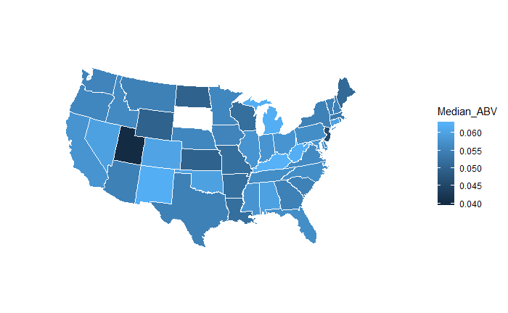
Statewide Comparisons
As now we now know there’s a correlation, we examined the states “All Hopped Up” wanted to introduce a product to.
This helps us better understand how our product will stand out in the current market data.
In this chart for example, we can see that Texas has a generally higher than average median ABV, where surrounding states are slightly lower.
A higher ABV beer would have slightly less competition in these states.

Slide 10
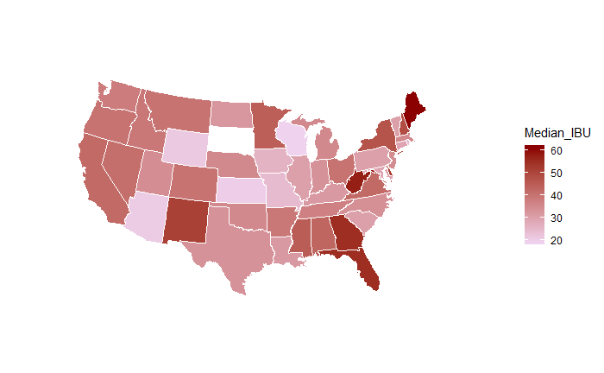
Statewide Comparisons
As we continue our comparison to examine the IBU market, we can see that we also see a rather low bitterness level for our states of interest.
This could also continue to provide a us a unique product to an existing market as we still desire to produce a new product that goes against both aspects of the beer we’d like to produce.

Slide 11
Some Additional Statewide Info
In addition to our statewide map, we wanted to examine the products and the locations of the max values for both variables we’d been observing.
MAX IBU: Astoria, OR produces the highest IBU at 138 as an American Double/Imperial IPA from Astoria Brewing Company with a beer named the "Bitter Bitch Imperial IPA".
MAX ABV: Boulder, CO produces the highest ABV at 12.8% from brewery Upslope Brewing Company for beer Lee Hill Series Vol. 5 - a Belgian Style Quadrupel Ale.

Slide 12
What We’ve Learned & Next Steps
Based on the data that is provided, we can conclude that:
A product with a high IBU would be competitive within Texas and states east of Texas.
A product with a high ABV would be competitive within Texas and states east of Texas.
Colorado has not only the highest number of breweries per state, but also the has the beer with the highest ABV. A new product like ours would not be competitive in that state.
From what we’ve learned we can begin to discover what product will best serve the Texas market and surrounding region.
All we need to do is find the right type of beer!

Slide 13
Top Beers of Texas
As we can associate a high ABV with a high IBU, we can evaluate what types of beers have both qualities.
From these qualities we can discover if the bittering agent hops is used in a type of beer we’re interested in producing.
Fortunately, Texas breweries top ABV and IBU follow a trend. It appears that the best interest in entering the Texas market would be to create a new American Double / Imperial IPA.
ABV | IBU | Style
0.099 | 100 | American Double / Imperial IPA
0.099 | 85 | American Black Ale
0.095 | 85 | American Double / Imperial IPA
0.092 | 100 | American Double / Imperial IPA
0.09 | 118 | American Double / Imperial IPA
0.085 | 90 | American Double / Imperial IPA
0.085 | 110 | American Double / Imperial IPA
0.085 | 110 | American Double / Imperial IPA
0.085 | 100 | American Double / Imperial IPA

Slide 14
Other Markets
After we’ve discovered what type of beer we suggest to produce, we want to see how it would fair in other markets that we expressed interest in previously.
We have already ruled out Colorado, as the market there is already immensely competitive due to the number of established breweries.
So the remaining markets to evaluate are:
Arkansas
Louisiana
Oklahoma

Slide 15
Other Markets Continued
Arkansas
1 Brewery producing an American Pale Ale (ABV 0.04, IBU 39)
Louisiana
3 Breweries, 10 beers, mostly consisting of Pale Ales (Mean ABU 0.054, Mean IBU 33)
Oklahoma
1 Brewery producing an American IPA (ABV 0.068, IBU 100)

Slide 16
Conclusions
Texas
Market consists of existing similar products
General interest in high ABV and IBU beers
This makes for a safe initial product entry
Could present difficulty as a new product due to existing competition
Other states
Very limited production of high IBU and ABV
Allows for a unique product space proven in other existing markets
Could be a radical product with little to no interest based on existing products

